Slide 1
Breast Cancer Survival Prediction
Supervised Machine Learning

Slide 2
Project Goals
Predict breast cancer survival status with clinical data
Binary classification problem
Help identify patients at risk of death
Find clinical data that is important to patient survival

Slide 3
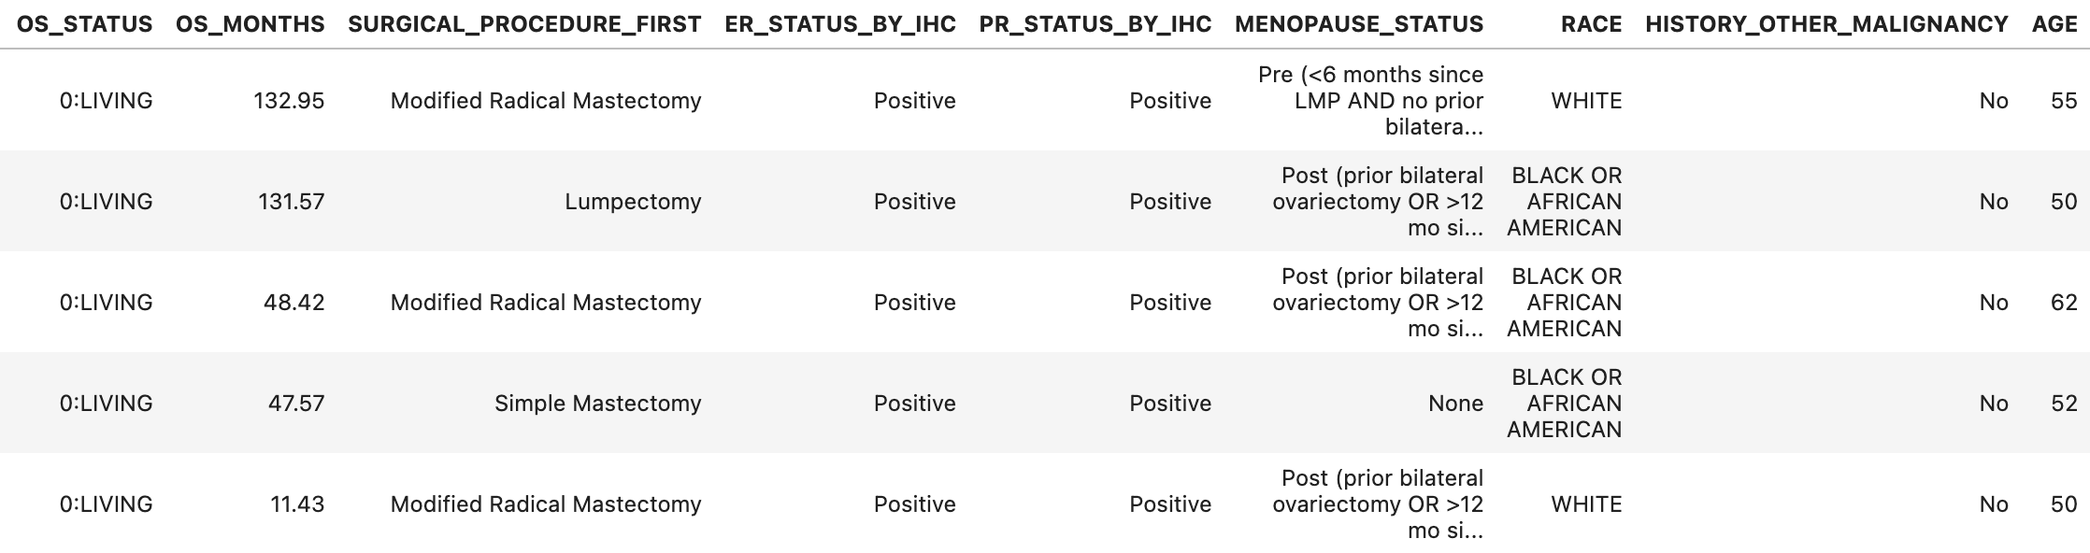
Data import
The Cancer Genome Atlas data on Breast Cancer
111 columns and 1097 different patients
Select 14 relevant columns to my project

Slide 4
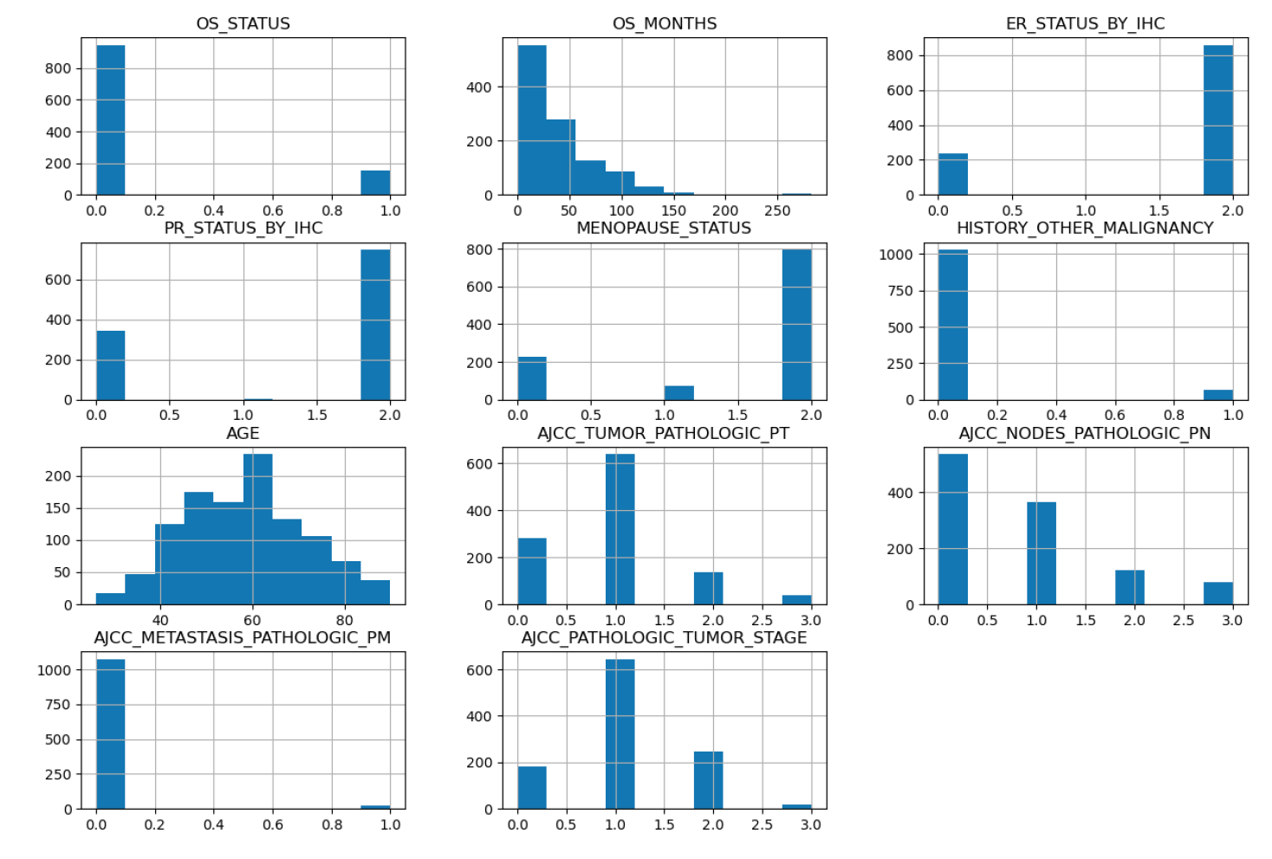
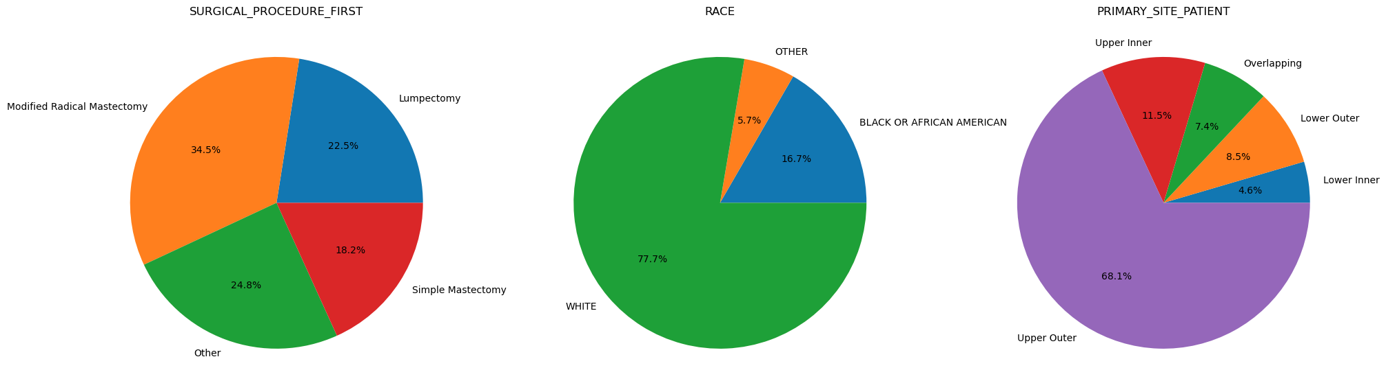
Data cleaning
Impute missing values:
For Categorical data: most common value
For Numerical data: median

Slide 5
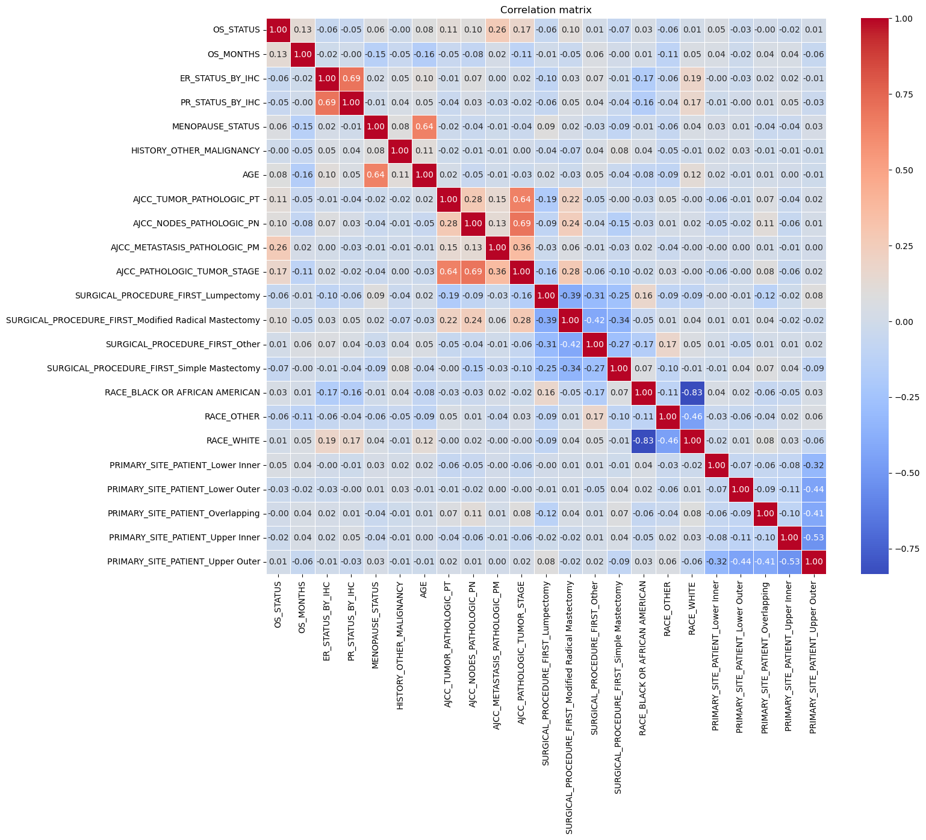
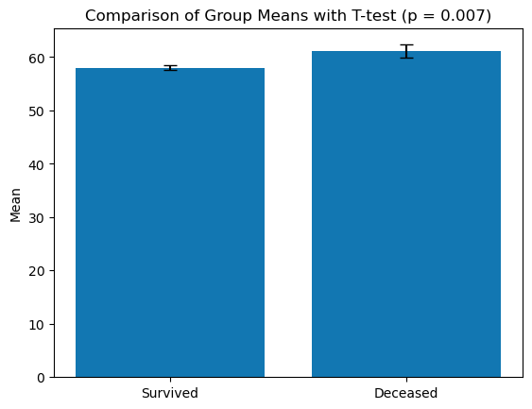
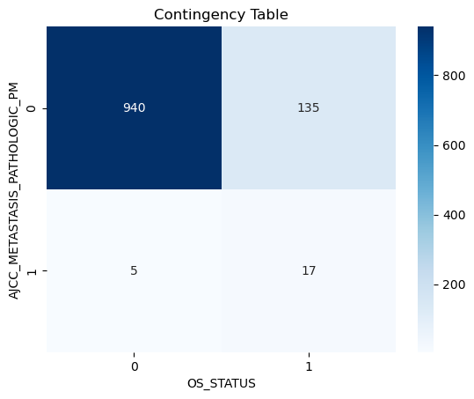
Correlation Matrix
OS status correlates with metastasis status, tumor stage, survival month, age
Age
Metastasis

Slide 6
Select important features
OS months
Tumor stage
Metastasis
Age
Estrogen response and Progesterone response
Menopausal status
Some others

Slide 7
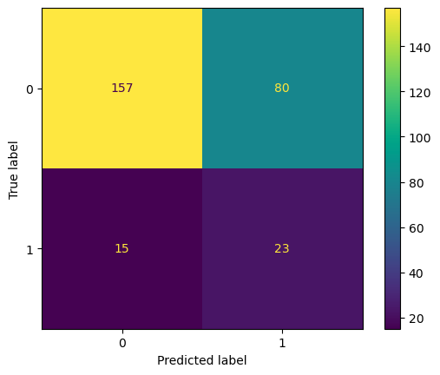
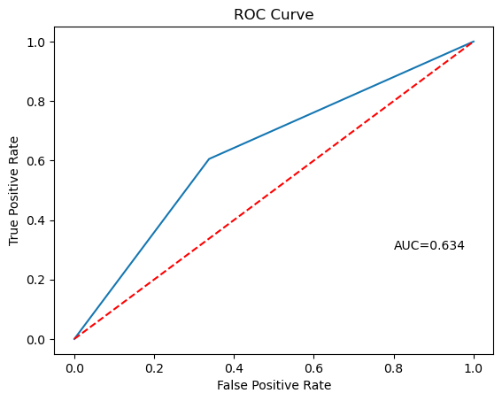
Logistic Regression Model
Binary Logistic Regression with balanced class weight
Accuracy: 0.655
Recall: 0.605
F1: 0.326

Slide 8
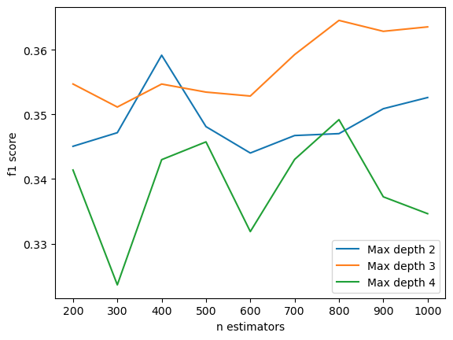
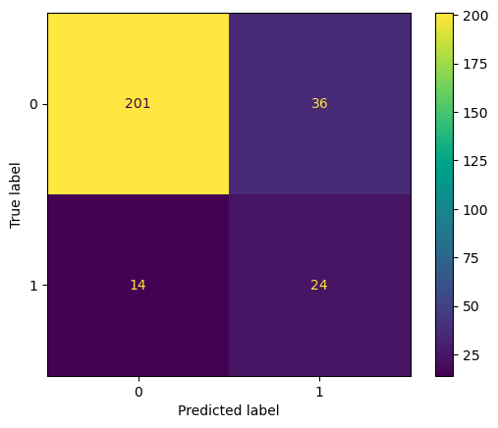
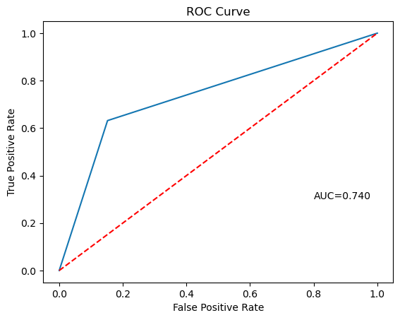
Random Forest
5-Fold Cross validation to find best hyperparameters
Accuracy: 0.818
Recall: 0.632
F1: 0.490

Slide 9
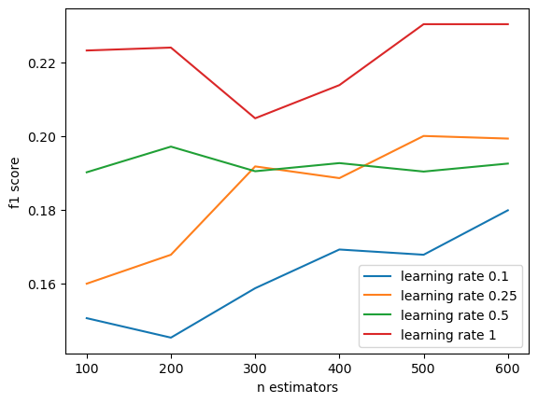
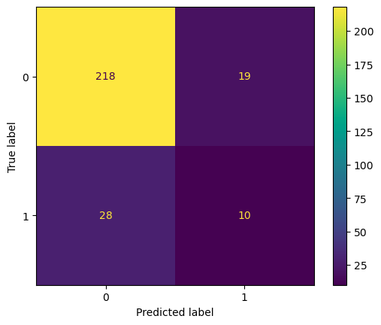
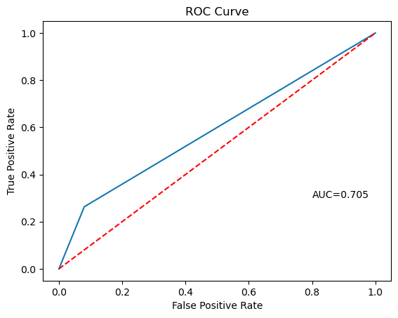
AdaBoost Classifier
5-fold Cross validation to find best hyperparameters
Accuracy: 0.829
Recall: 0.263
F1: 0.299

Slide 10
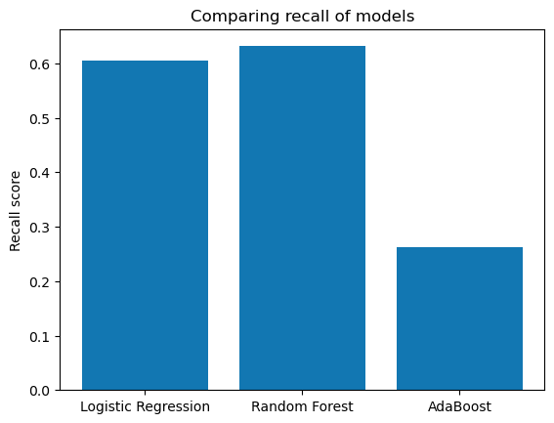
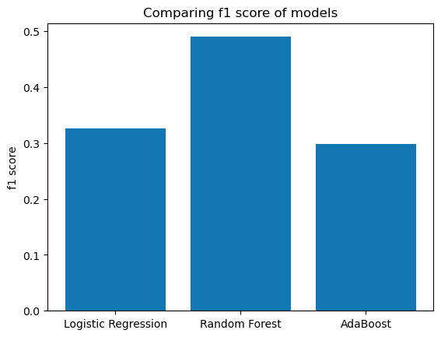
Compare models
Random Forest is the highest performing based on recall and f1.

Slide 11
Conclusion
Random Forest is highest performing
Important clinical features to patient survival: Age, Metastasis status, tumor stage, ER, PR status, and menopausal status
Drawback: low precision due to class imbalance (1:6)
Future improvements: up-sampling or down-sampling data for better data balance

